Slide 1
NLP
Fake vs Real
News Classification
An end to end text classification pipeline: from raw headlines to best performing models
FAKE label = 0
Team: Martin, Jenifar, Yoan, Manu
REAL label = 1
2026-07-31
Notes:
End to end NLP project classifying news headlines as fake (0) or real (1). Covers data prep, feature engineering and five models.

Slide 2
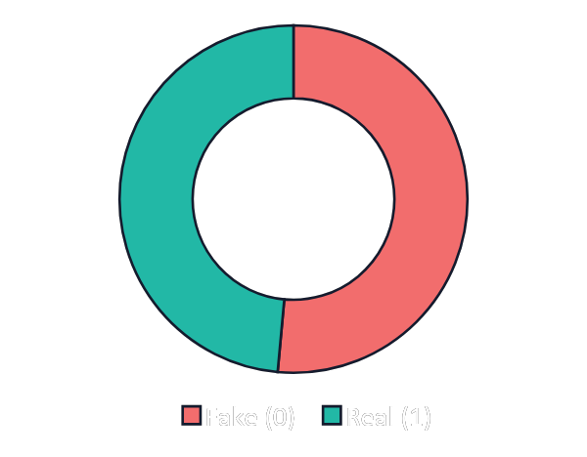
The problem and the data
1,946
exact duplicate rows detected in the raw data
Class balance duplicates
Within the group of headlines y_prediction_probability below 0.8 (1155 headlines) there are 25% duplicates.
(7% of all headlines are duplicates.)
Roughly balanced: 51% fake, 49% real
Notes:
34,152 rows, two columns, no nulls. Classes are close to balanced so accuracy is a fair headline metric. 1,946 duplicates were noted in the raw copy.

Slide 3
Removing duplicates first
The raw file held 1,946 exact duplicate headlines. Dropping them before the split keeps the same text out of both train and test.
−1,946
Why it matters
Before
After
34,152
32,206
A duplicate in both splits lets the model memorise a row it will later be tested on, inflating the score.
rows, with duplicates
unique headlines
Effect on results
Every accuracy in this deck is measured on the de-duplicated data. Scores sit a little lower than a run with duplicates left in, but they are a more honest estimate of how the model handles genuinely unseen headlines.
Notes:
drop_duplicates removed 1,946 rows, 34,152 to 32,206. Doing this before the split avoids leakage where an identical headline appears in train and test. All later numbers use the cleaned set.

Slide 4
Cleaning: diagnose first, then act
A diagnostic pass counted quality issues per class before any text was changed, so cleaning choices were evidence based.
Special characters
Very short texts
Extra whitespace
Present in both classes at similar rates
9 found, only in fake news
192 found, only in real news
Decision: Removed — not a class signal
Decision: Kept — a genuine fake-news cue
Decision: Normalised during cleaning
Cleaning applied to the whole set
remove special characters → normalise whitespace → strip → lowercase
Notes:
Diagnostics counted urls, html, special chars, whitespace, very short and very long texts per label. Special chars removed, short texts kept as a signal, whitespace normalised.

Slide 5
From raw text to features
Split before anything is fit. The vectorizer learns only from training text, then transforms the test set.
›
›
›
›
›
1
2
3
4
5
6
Clean
Split
Tokenize
Stopwords
Lemmatize
Vectorize
special chars, case, whitespace
80 / 20 stratified
word_tokenize
NLTK English list
WordNetLemmatizer
BoW and TF-IDF
Train / test split
27,321 training 6,831 test
Notes:
Six step pipeline. Splitting before fitting the vectorizer prevents data leakage. TF-IDF was chosen over plain bag of words as the main feature set.

Slide 6
Five models, one feature philosophy
Four classical models on sparse TF-IDF features, plus one dense embedding model and one pretrained transformer for contrast.
1
Logistic Regression
Default TF-IDF, default classifier — the baseline
2
Logistic Regression, tuned
C = 3, TF-IDF with max_df 0.8, min_df 2, bigrams
3
Multinomial Naive Bayes
Same tuned TF-IDF, probabilistic classifier
4
LightGBM + Word2Vec
Dense 100-d document vectors, gradient boosting
5
Pretrained transformer
Off-the-shelf sentiment model, used as a probe
Notes:
Models 1-3 share sparse TF-IDF. Model 4 uses dense Word2Vec averages. Model 5 is a pretrained transformer used as a probe.

Slide 7
Logistic Regression face-off
Model 1 uses default TF-IDF. Model 2 adds fine-tuning: max_df 0.8, min_df 2, n-grams=(1,2) and C = 3. The accuracy gain is marginal.
Model 1 · default
+0.11%
Model 2 · fine-tuned
Plain TF-IDF, default LogReg
max_df 0.8, min_df 2, n-grams=(1,2), C = 3
92.52% test
92.63% test
Train 95.44% · gap 2.92%
Train 95.96% · gap 3.33%
What the fine-tuning bought
Vocabulary trimming and bigrams lifted test accuracy by only 0.11 points. In short, keyword-driven headlines the default TF-IDF already captures most of the signal, so heavier feature engineering gives diminishing returns. Model 2 was still chosen for deployment for its cleaner, capped feature space.
Notes:
Model 1 default TF-IDF 92.52 test. Model 2 fine-tuned 92.63 test, a 0.11 point gain. The tuning barely moved accuracy because headlines are short and keyword driven; Model 2 was deployed for its smaller, capped vocabulary.

Slide 8
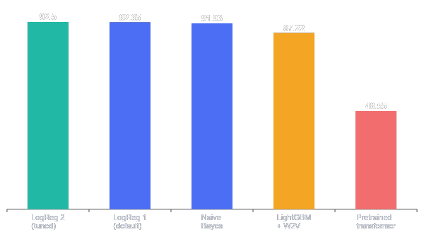
Best logistic regression vs the field
Held-out 6,442 headline test split. The tuned logistic regression leads; the pretrained transformer collapses to near chance.
92.63
92.52
92.63%
Best & deployed · tuned LogReg
1.52%
Smallest train–test gap · Naive Bayes
48.55%
Pretrained transformer · wrong tool
A financial-sentiment model has no notion of fake vs real, so it predicts one class and stalls near 49%.
Notes:
Tuned LogReg 92.63 leads. Default 92.52. Naive Bayes 91.93 with tightest gap. LightGBM+W2V 87.22. Pretrained transformer 48.55 because it was a sentiment model.

Slide 9
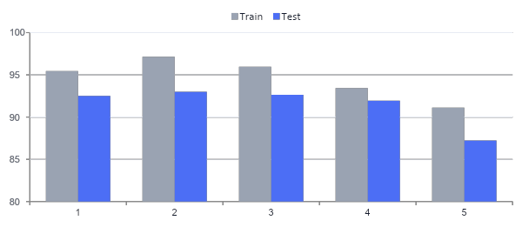
Accuracy
Train vs test exposes overfitting. The grid search reached a higher test score but opened the widest gap, so it was set aside.
Set aside
GridSearch C=3 93.01% test, but the widest 4.12% train–test gap. Higher score, weaker generalisation.
Deployed
LogReg tuned (C=3) 92.63% test with a controlled 3.33% gap and a capped 5k feature space. Best balance of accuracy and stability.
Train – test gap
Stable generalization
2.92%
4.12%
3.33%
1.52%
3.88%
LogReg
default
GridSearch
C=10
LogReg Tuned
C=3
Naive
Bayes
LightGBM
+ W2V
Notes:
Train vs test bars per model with the exact train-test gap shown below each. GridSearch C=3 has the widest gap at 4.12 percent despite the top test score; Naive Bayes the tightest at 1.52; the deployed tuned LogReg sits at 3.33.

Slide 10

Preprocessing - Raw Data

Slide 11
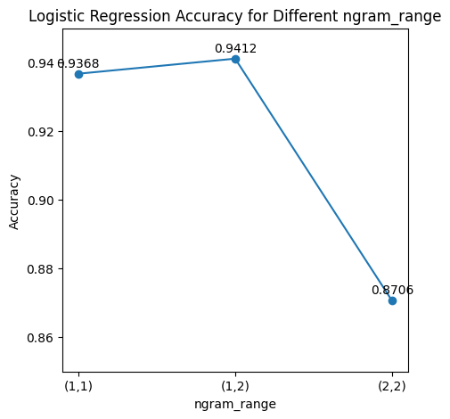
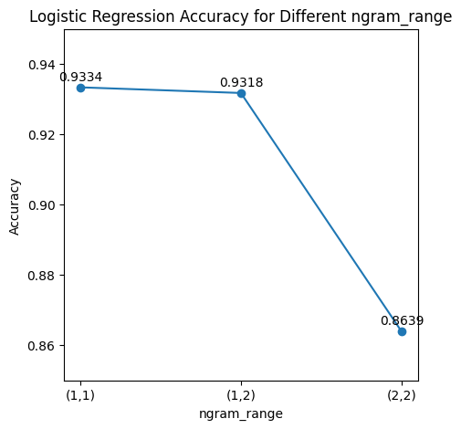
ngram_range tuning
Testing unigram, bigram and combined features
CountVectorizer
TF-IDF
Combined unigrams + bigrams, ngram_range=(1,2), gives the best Logistic Regression result. Pure bigrams, ngram_range=(2,2), lose too much single-word signal.

Slide 12
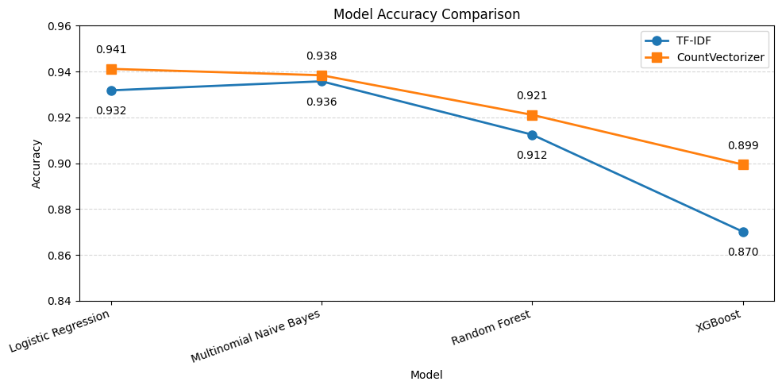
Model comparison
Four classifiers compared with two vectorizers
What the chart shows
CountVectorizer is slightly stronger than TF-IDF for all tested models. Logistic Regression and Multinomial Naive Bayes are the best performers, while XGBoost performs lowest in this setup.
Best model
Logistic Regression + CountVectorizer
Accuracy: 0.941

Slide 13
Comparing Two Pipelines
Two teammates, Jenifar and Yoan, built independent pipelines on the same training and test data — and both independently arrived at the same first fix: removing duplicates.
32,206
unique headlines left after both pipelines removed 1,946 duplicate rows
What each pipeline tested
Jenifar
5
models compared by Jenifar — including embeddings and a transformer
Full NLTK pipeline (stopwords + lemmatization), TF-IDF, 5 models — including Word2Vec + LightGBM and a pretrained transformer
Yoan
8
vectorizer × model combinations retested by Yoan on the deduplicated set
Lightweight cleaning, CountVectorizer / TF-IDF × 4 models, n-gram fixed at (1,2) after an earlier sweep
Notes:
Intro slide: sets up that we're comparing two independent teammate pipelines on the same data before presenting the model comparison.

Slide 14
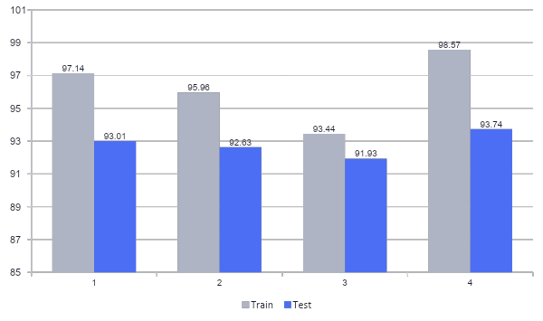
Accuracy Is Not the Full Picture
The two highest-scoring models across both notebooks also opened the widest train–test gaps.
High gap
GridSearch LR
4.12 pt gap
highest gap
NB + CountVec (Yoan)
4.83 pt gap — highest of all
BEST BALANCED
LR tuned (C=3)
3.33 pt gap
BEST GENERALIZATION
Naive Bayes (Jenifar)
1.52 pt gap — smallest of all
Notes:
Post-dedup: Jenifar's GridSearch LR (4.12pt) and Yoan's Naive Bayes+CountVec (4.83pt) overfit most. Jenifar's own Naive Bayes generalizes best (1.52pt gap) — same algorithm family as Yoan's, very different overfitting behavior.

Slide 15
Three Winners, Three Criteria
Instead of declaring one best model, we ranked the candidates by what actually matters for each use case.
BEST RAW ACCURACY
BEST GENERALIZATION
BEST BALANCE
93.74%
91.93%
92.63%
Yoan — Naive Bayes + CountVectorizer (1,2)
Jenifar — Naive Bayes (capped TF-IDF)
Jenifar — Tuned Logistic Regression (C = 3)
Disadvantage
Disadvantage
Disadvantage
Highest overfitting gap of the compared models (4.83 pts) — despite Naive Bayes usually being the ‘safe’ choice.
Lowest raw accuracy of the four; assumes word independence, a known simplification.
Not #1 on either single metric — but the one the team actually shipped.
Notes:
The 'no single winner' slide — each model is #1 on a different, defensible criterion, with an honest disadvantage attached.

Slide 16
Bigger Isn’t Always Better
Two more advanced approaches were tested. Neither outperformed the simple TF-IDF baseline.
Word2Vec + LightGBM
Pretrained Transformer
Every headline became one 100-d vector by averaging its word vectors, then LightGBM classified on top.
An off-the-shelf financial-sentiment model was applied directly, with no fine-tuning on this dataset.
87.22%
48.55%
test accuracy — below every TF-IDF model
accuracy — essentially one-class guessing
Why lower? Averaging blurs word-level signal — for short headlines, sparse TF-IDF keyword evidence is simply stronger.
Sentiment (positive/negative) doesn’t map to veracity (fake/real) — it would need fine-tuning on this exact task to be a fair comparison.
Notes:
Neither detour beat the TF-IDF baseline. Framed as a lesson, not a failure: sophistication only helps when matched to the task.

Slide 17
What This Comparison Shows
1
No single winner
The best model changes depending on whether you optimize for raw accuracy or for generalization.
2
Preprocessing shapes overfitting too
The same algorithm, Naive Bayes, swung from a 1.5-point to a 4.8-point train–test gap purely on vocabulary capping and lemmatization — not just the model choice.
3
Match the tool to the task
A pretrained model only transfers when its training objective aligns with yours — sentiment ≠ veracity.
4
The Health Tech parallel
A model that memorizes training data but fails to generalize is a serious risk in production — whether it’s flagging fake news or classifying clinical notes.
Generalization first: in production, reliability on unseen data matters more than a fraction of a point in accuracy — and that reliability comes from the full pipeline, not just the algorithm.
Notes:
Closing slide. Deliberately does not declare a single 'final model' — the team's message is that the right choice depends on the priority.

